Slide 1
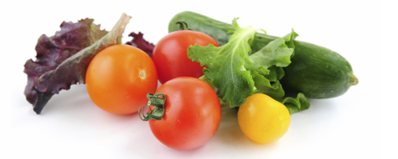

What is the deal with bioengineered food labeling?
Jennifer L. Allen –
Zwillinger Wulkan

Slide 2
WHAT IS A BIOENGINEERED FOOD?
A food that contains genetic material that has been modified through in vitro recombinant deoxyribonucleic acid (rDNA) techniques and for which the modification could not otherwise be obtained through conventional breeding or found in nature; provided that:
  Such a food does not contain modified genetic material if the genetic material is not detectable.
  Not a bioengineered food if it is an incidental additive present in food at an insignificant level and that does not have any technical or functional effect in the food.
  Does not include cross-bred products – such as two animals bred together, or two types of plants spliced together.
  Commonly referred to as genetically-modified or GMO.
  May include CRISPR if not an edit that can occur naturally.

Slide 3
WHERE HAVE WE COME FROM?
Individuals are at odds over whether bioengineered foods are a blessing or a curse.
Some view them with suspicion and have concerns about their impact on health.
Others view them as miracle foods that grow in tougher climates, can fend off more pests, and might help offer a solution as to how to feed the more than 7.5 billion hungry mouths on our planet.
The FDA doesn’t generally require food manufacturers to disclose that foods are bioengineered, because the FDA generally considers such foods to be safe and materially identical to their conventional counterparts.

Slide 4
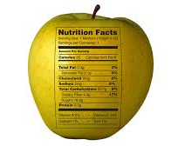
WHERE HAVE WE COME FROM? (Continued)
FDA looks at three things – allergens, toxins, and nutritional value.
In fact, the FDA has even suggested that it is misleading to label food as not being bioengineered because doing so could cause the consumer to believe that bioengineered foods are inherently
bad.

Slide 5
SO, WHY ARE WE TALKING ABOUT THIS TODAY?
Congress wanted to preempt state laws like those in Vermont, and in 2016, passed the National Bioengineered Food Disclosure Law, directing the USDA to establish mandatory standards for disclosing bioengineered foods.
The National Bioengineered Food Disclosure Standard was born on January 1, 2020, and you can find it in the Electronic Code of Federal Regulations (eCFR) at 7 CFR 66.
All regulated entities had to comply by January 1, 2022.

Slide 6
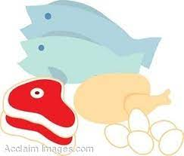
SO, WHAT DOES THIS MEAN TO ME?
So, what does that mean to you?
First things first, what do you produce?
  The standard applies to all foods that are subject to FDA labeling requirements, but it doesn’t apply to food regulated under the meat, poultry, or egg product inspection acts unless the pre-dominant ingredient in the food item is regulated by the FDA.
  If you produce, for example, whole chickens, then the standard doesn’t apply.
Weird regulatory landscape because USDA is regulating foods that are ultimately regulated by FDA, perhaps because of the agricultural aspect of these foods.

Slide 7
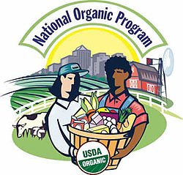
DO I QUALIFY FOR AN EXEMPTION?
Even if your food is regulated by the FDA, you may nevertheless qualify for an exemption.
The following foods are exempt:
  Food served in restaurants and other similar retail establishments;
  Food manufacturers with annual receipts of less than $2.5 million;
  Food ingredients containing five percent or less of inadvertently-added and unavoidable bioengineered ingredients;
  Foods derived from animals that have consumed feed that is in any way bioengineered; and
  Foods certified under the National Organics Program.

Slide 8
I’M NOT EXEMPT – WHAT NOW?
If your food otherwise falls under the standard and you don’t qualify for an exemption, look at the List of Bioengineered Foods which you can find at 7 CFR 66.6.
If your product contains any of the foods on the list, then you must disclose unless you can show that your ingredients are not bioengineered.
Even if your product does not contain any of the foods on the list, you must still disclose if you have actual knowledge that it contains bioengineered ingredients.

Slide 9

WHAT MUST THE DISCLOSURE LOOK LIKE?
Disclosure can be in the form of a text disclosure, a symbol, an electronic or digital link or a text message. The details are at 7 CFR 66.102-66.108.
Manufacturer or importer is responsible for the disclosure if the food is packaged at that point.
For food packaged by the retailer, or that the retailer sells in bulk, the retailer is responsible for the disclosure.
Must be of sufficient size and clarity to appear prominently and conspicuously on the label.

Slide 10
WHAT MUST THE DISCLOSURE LOOK LIKE? (Continued)
Likely to be read and understood by consumer under ordinary shopping conditions;
Must be placed either on the information panel, adjacent to the name and location of the manufacturer, importer or similar;
On the principal display panel; or
On an alternate panel if there isn’t room elsewhere, so long as it will be read and understood by the consumer under ordinary shopping conditions.

Slide 11
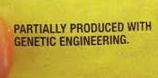
TEXT DISCLOSURES
If a food (including any ingredient produced from such food) is on the List of Bioengineered Foods and records maintained by a regulated entity demonstrate that the food is bioengineered:
  “Bioengineered food” or “Bioengineered foods”
  “Contains a bioengineered food ingredient” or
  “Contains bioengineered food ingredients”

Slide 12
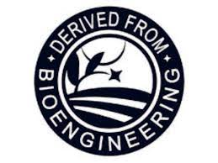
SYMBOL DISCLOSURE
If a food (including any ingredient produced from such food) is on the List of Bioengineered Foods, and records maintained by a regulated entity demonstrate that the food is bioengineered, or do not demonstrate whether the food is bioengineered:
  May be in black and white.
  Nothing may be added or subtracted.
Figure 1 to § 66.104

Slide 13
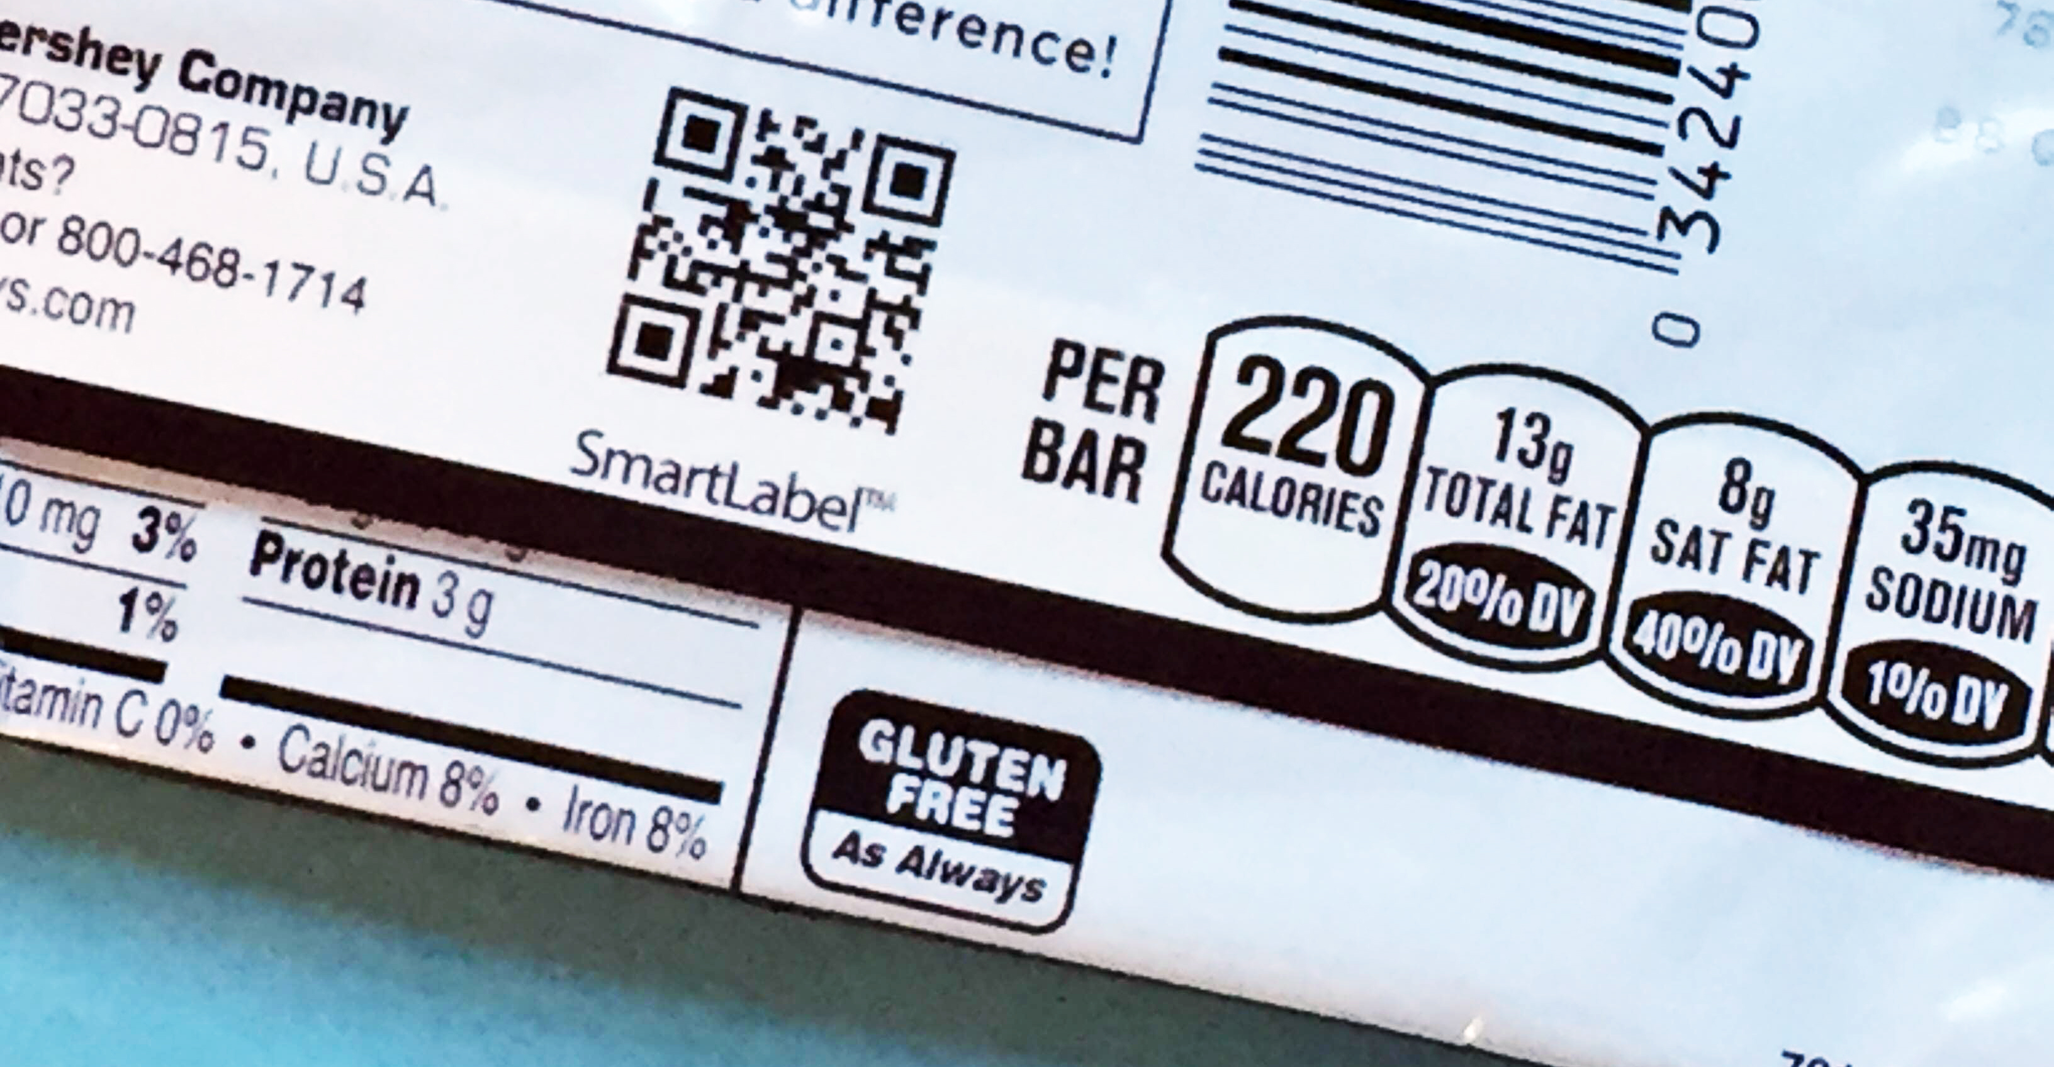
ELECTRONIC OR DIGITAL LINK DISCLOSURE
“Scan here for more information” or “Scan anywhere on package for more information” or “Scan icon for food information” etc.
Accompanied by phone number that will provide information 24/7: “Call [1-000-000-0000] for more food information.”
Link must go directly to product information page and:
  Must be first screen to appear;
  Must contain the disclosure discussed earlier;
  Must exclude promotional and marketing material; and
  Cannot collect consumer cell phone information
  But note that a court recently ruled that this disclosure is insufficient

Slide 14

DISCLOSURE FOR SMALL FOOD MANUFACTURERS
May use one or the other methods -or- one of the following two methods of disclosure:
  “Call for more food information,” with a telephone number providing pre-recorded disclosure.
  “Visit [URL of website] for more food information,” and website meets requirements discussed earlier.

Slide 15
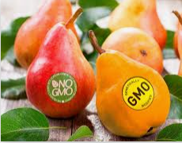
BULK CONTAINERS
Same disclosure requirements as for other foods.
Disclosure must be on a placard, sign, sticker etc. that allows consumers to easily identify and understand the bioengineered status of the food.

Slide 16
SMALL AND VERY SMALL PACKAGES
“Scan for info;”
Number or short code plus “Text for info;”
Phone number and “Call for info;”
Must meet other requirements once consumer reaches out for more information; or
For very small packages, if there is already a URL for general food information, the link can also include the appropriate bioengineered food disclosure.

Slide 17
WHAT FOODS ARE ON THE LIST?
As of current date, the list consisted of:
  Alfalfa
  Certain apple varieties
  Canola
  Corn
  Cotton
  Certain eggplant varieties
  Certain papaya varieties
  Certain pineapple varieties
  Potato
  AquAdvantage salmon
  Soybean
  Summer squash
  Sugarbeet

Slide 18
WHAT FOODS ARE ON THE LIST? (Continued)
USDA’s Agricultural Marketing Service will update the list annually. Firms have eighteen months to comply whenever new foods are added to the list.
If your food isn’t on the list, but you know it is bioengineered, then these regulations apply.

Slide 19
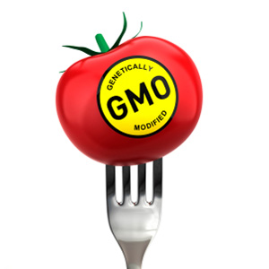
VOLUNTARY DISCLOSURE
Even exempt manufacturers/retailers, etc. may choose to disclose.
What if your food is derived from a food on the list, and it isn’t exempt, but it doesn’t actually meet the definition of a bioengineered food as we discussed earlier?
In that case, you may use different language in the disclosure:
  Text disclosure stating, “derived from bioengineering” or “ingredient(s) derived from a bioengineered source.” The word “ingredient(s)” may be replaced with the name of the specific crop(s) or food ingredient(s).

Slide 20
VOLUNTARY DISCLOSURE (Continued)
Symbol disclosure should look like this:
Or you can use the other types of disclosure discussed above, with the modified languages
Figure 1 to § 66.104

Slide 21
WHAT ABOUT DETECTABILITY?
You don’t need to disclose under this rule if any modified genetic material is undetectable.
This means that you don’t need to disclose if you maintain any one of three different types of records:
  Records verifying that the food is sourced from a non-bioengineered crop or source;
  Records verifying that the food has undergone a refinement process validated to make the modified genetic material undetectable; or
  Certificates of analysis or other records of testing that confirm the absence of any modified genetic material.

Slide 22
ANALYTICAL TESTING
Analytical testing to ensure the validity of any process used to render modified genetic material undetectable must meet certain requirements:
  Laboratory quality assurance must ensure validity of test results;
  Analytical method selection, validation, and verification must ensure that the testing method used is appropriate (fit for purpose) and that the laboratory can successfully perform the testing;
  The demonstration of testing validity must ensure consistent, accurate analytical performance; and
  Method performance specifications must ensure analytical tests are sufficiently sensitive for the purposes of the detectability requirements of this part.

Slide 23
ANALYTICAL TESTING (Continued)
This analytical testing must be used to validate that a refining process renders modified genetic material in a food undetectable.
Once you’ve validated the method, you don’t need any other testing to confirm the absence of detectable modified genetic materials so long as you don’t make any significant changes to
the validation process, and you keep records showing that the refining process has been validated and that the validated
refining process is followed.
An example – soy lecithin derived from bioengineered soybeans.

Slide 24
PUTTING IT ALL TOGETHER
These regulations are complex.
Putting it all together and assuming no exemptions apply:
  If your product contains a food on the list, you must disclose unless you have records showing it is not bioengineered or that the bioengineered components are not detectable;
  If your product does not contain a food on the list, then no disclosure is needed unless you know it is bioengineered, and no need to maintain records proving it is not bioengineered.
Think of it as being that there is a presumption with foods on the list that they are going to be bioengineered, so if yours isn’t, then you need to be able to prove it; and if you can’t, then you need to make the disclosure.

Slide 25

DOCUMENT, DOCUMENT, DOCUMENT
Customary and reasonable records that demonstrate compliance with disclosure requirements.
Electronic or paper.
Sufficient detail to be readily understood and audited
by AMS.
Kept for at least two years after the food is sold or distributed.

Slide 26
DOCUMENT, DOCUMENT, DOCUMENT (Continued)
Examples include:
  Supply chain records, bills of lading, invoices, supplier attestations, labels, contracts, brokers’ statements, third-party certifications, laboratory testing results, validated process verifications and other records generated or maintained by the regulated entity in the normal course of business.
  Must maintain records for foods that are on the list and for foods not on the list if the manufacturer knows they constitute a bioengineered food or contain bioengineered ingredients.

Slide 27
PETITIONS
Anyone may petition AMS regarding a determination of other factors and conditions under which a food is considered bioengineered.
If the petition satisfies the standards for consideration, AMS
will initiate a rulemaking that would amend the definition of bioengineered food.

Slide 28
SO, WHAT’S NEXT?
This regulation might settle the debate over which foods must be labeled, but it almost certainly won’t settle the debate among consumers over whether bioengineered foods are a blessing or a curse.
That debate is likely to rage on.

Slide 29
HOW TO REACH ME
Questions? You can reach me at:
  Jennifer.allen@zwfirm.com
  602 962 5738
  Or connect with me on LinkedIn

